Slide 1
Introduction to Health Data Science and Health Informatics
Andrea Hobby
BlackTIDES Epidemiology Lead
https://www.linkedin.com/in/andreahobby/

Slide 2

Who Am I?
Epidemiology Lead for BlackTIDES
Founder of Health Data Science Newsletter
Incoming Data Scientist at US Department of Health and Human Services
Data Scientist at Accenture Federal Services
Former Data Science Fellow at the FDA
Graduated with MS in Epidemiology from Georgetown and Certificate in Data Science
BA Political Science from Wellesley College

Slide 3
Agenda
Introduction
Health Informatics Overview
Health Data Science Overview
R Overview
Real-world Applications with R - Health Informatics and Health Data Science

Slide 4
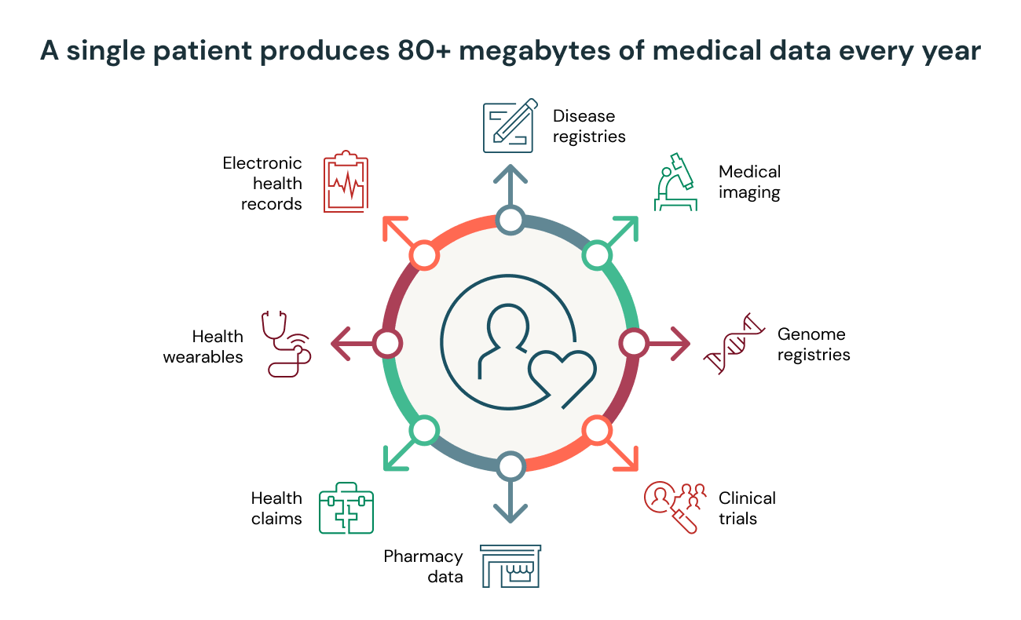
What is data?
Data is raw material
Source
Notes:
Health care data are raw health care facts, generally stored as characters, words, symbols, measurements, or statistics. Health care data by itself is not useful for decision making. Health care data may describe a particular event, but alone and unprocessed they are not particularly helpful. We can see an example on the the next slide of the the difference between data and information.
some key types of health data:
Clinical Data:
Electronic Health Records (EHRs) and Electronic Medical Records (EMRs): Contain information about patient demographics, visit notes, medications, vital signs, immunizations, laboratory data, and other health-related data.
Clinical Decision Support Systems (CDSS): Data that helps guide clinical decisions.
Images: Radiological and other diagnostic images like X-rays, MRIs, CT scans, and ultrasound images.
Prescription Data: Information about medications prescribed and dispensed.
Genomic and Molecular Data:
DNA Sequencing Data: Genetic information from whole genome sequencing, exome sequencing, or targeted sequencing.
Proteomics: Data related to the study of protein structures and functions.
Metabolomics: Data related to the study of metabolic processes.
Administrative and Claims Data:
Billing Data: Information from patient bills and insurance claims, often used for cost-related studies.
Insurance Claims Data: Information from insurance claims, including diagnosis codes, procedure codes, and medications.
Patient-Generated Data:
Wearable Devices: Data from smartwatches and fitness trackers that record steps, heart rate, sleep patterns, etc.
Patient Surveys and Diaries: Information self-reported by patients, which can include symptoms, medication adherence, and lifestyle choices.
Mobile Health Apps: Data recorded and/or entered into health-related mobile applications.
Population and Public Health Data:
Surveillance Data: Information related to the monitoring of diseases in populations.
Epidemiological Data: Data used to study the patterns, causes, and effects of health and disease in populations.
Vaccination Records: Data regarding immunization status and schedules.

Slide 5
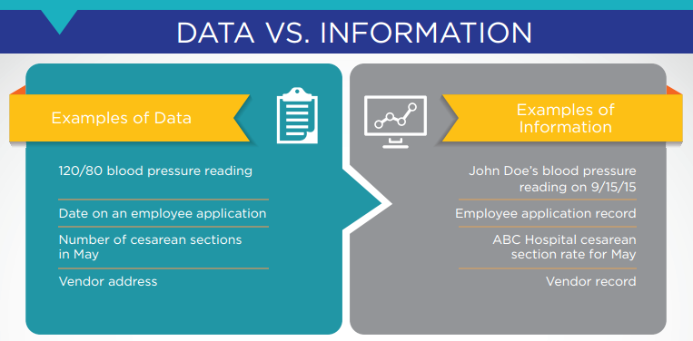
What is information?
information is processed health data.
Source
Notes:
Take, for example, this figure: we have a single data point for blood pressure. By itself, what does it mean? If we process this data further by indicating that it represents the Johns blood pressure on a certain day, it then takes on more meaning.
With the additional facts attached, this can become infor­mation. .

Slide 6
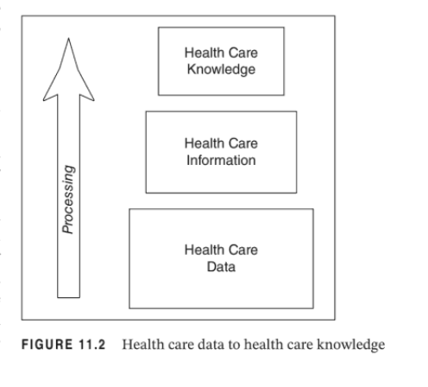
What is knowledge?
Knowledge is information that is applied to rules, relationships, ideas, and experiences.
Notes:
A way to think about knowledge is that it is information applied to rules, expe­ riences, and relationships with the result that it can be used for decision making. Data analytics applied to health care information and research studies based on health care information are examples of transforming health care information into new knowledge.

Slide 7
What is Health Informatics?

Slide 8
Health Informatics is the science of how to use healthcare data, health information and knowledge to improve human health and the delivery of health care services
Notes:
To me, Health Informatics is more concerned with security, privacy, data standards, interoperability, system architecture, and legal compliance of electronic health records or electronic lab reporting informations systems.

Slide 9
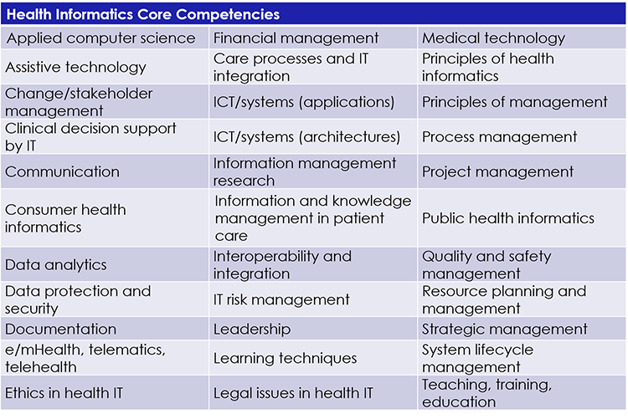
Source:https://www.himss.org/resources/health-informatics
Notes:
Clinical decision support
Assistive technology - any item, piece of equipment, or product system, whether acquired commercially off the shelf, modified, or customized, that is used to increase, maintain, or improve functional capabilities of individuals with disabilities.
Telematics - the branch of information technology which deals with the long-distance transmission of computerized information.
Telehealth - healthcare remotely by means of telecommunications technology.
Public health informatics - Public health informatics is the systematic application of information, computer science, and technology to public health practice, research, and learning.
Consumer health informatics - Consumer health informatics examines patient information from points of view such as health literacy, consumer knowledge, and education. The goal is to empower patients while giving them the knowledge they need to make their own health decisions.
ICT/systems - Health ICT (Information and Communication Technologies) is based on the development of digital technologies, databases, and other applications that seek to prevent illness, treat diseases, manage chronic illness while improving healthcare for individuals and communities, and also provide capacity for system
Interoperability and Integration
system lifecycle management - the administration of a system from provisioning, through operations, to retirement. Every IT system, resource, and workload has a life cycle.
Process management - methods and technologies aimed at analyzing, optimizing, harmonizing, and automating clinical workflows through holistic re-engineering of healthcare processes
Medical technology

Slide 10
What is Health Data Science?

Slide 11
Health Data Science = Statistics + Health Informatics + Computer Science + Healthcare subject matter expertise
Notes:
Health Data Science is an Always evolving field.
Health Data Science is an interdisciplinary field that combines principles from data science, computer science, statistics, and domain-specific knowledge in healthcare and medicine to extract valuable insights and knowledge from healthcare-related data. It involves the collection, storage, analysis, and interpretation of data to improve patient outcomes, healthcare delivery, and medical research.

Slide 12
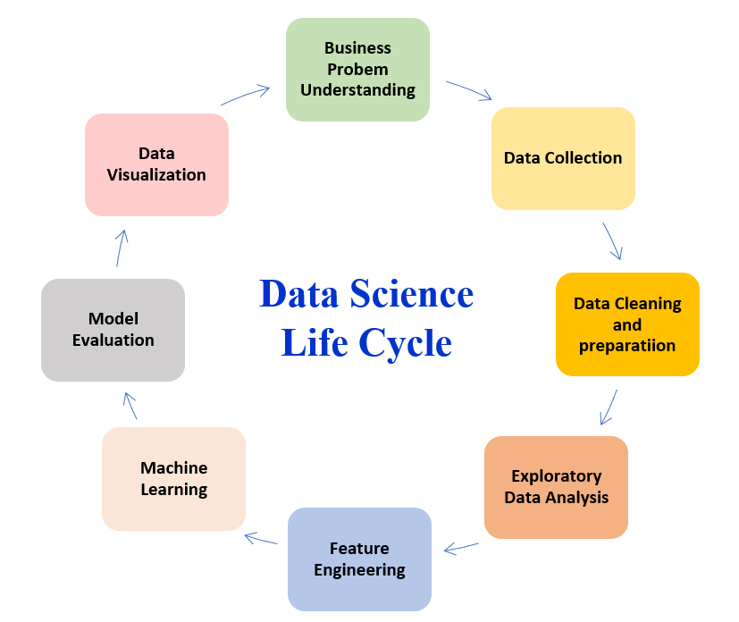
Data Science Lifecycle
Source
Notes:
Business Understanding - understand the business..how decisions are made …what the end user and decision makers really needs
Data Collection:
Involves gathering raw data from various sources, including databases, APIs, sensors, and more.
Data Cleaning (Data Preprocessing):
Addresses missing values, outliers, and inconsistencies in the data to ensure its quality and reliability.
Exploratory Data Analysis (EDA):
Examines and visualizes data patterns and trends to gain insights into its characteristics. Basic Stats here.
Feature Engineering:
Involves selecting, transforming, or creating new features from the existing data to improve model performance.
Machine Learning:
Select algorithm. Encompasses the development and application of algorithms that enable computers to learn patterns from data and make predictions or decisions.
Evaluation and Validation:
Assesses the performance of models using metrics and validation techniques to ensure their accuracy and generalizability.
Data Visualization:
Communicates findings effectively through visual representations such as charts, graphs, and dashboards.
BONUS-
Data Ethics and Privacy:
Addresses ethical considerations and ensures the responsible use of data, including privacy and security concerns.
Domain Expertise:
Requires understanding the specific domain or industry context to interpret results and make data-driven recommendations.
Communication Skills:
Involves effectively conveying complex findings and insights to both technical and non-technical stakeholders.
Deployment and Integration:
Implements models into real-world applications and integrates them with existing systems.
Continuous Learning/Data Monitoring:
Staying updated with the latest technologies, techniques, and tools in the rapidly evolving field of data science. Also, looking for data drift.

Slide 13
What are some key areas of health data science?
Natural Language Processing - i.e., Extracting patient diagnoses from clinical notes in EHR.
Computer Vision - i.e., Analyze a radiology image using an image recognition algorithm.
Machine Learning - i.e., Build a model to predict the utilization of healthcare resources for a hospital.
Reinforcement Learning - This can be used to design personalized treatment plans by continuously adapting interventions based on patient responses.
Causal Inference - This can determine the effectiveness of a treatment by comparing outcomes in a treated group against a control group.

Slide 14
What are similarities between health data science and health informatics?
Health Data Science and Health Informatics rely heavily on data to drive decision-making and improve healthcare outcomes. They involve collecting, storing, processing, and analyzing data for insights.
They both are multidisciplinary, drawing from computer science, statistics, medicine, biology, and public health.
Health Informatics often involves managing and utilizing electronic health records (EHRs), while Health Data Science may work with data from EHRs to perform analyses.
Both fields conduct research and analysis to gain insights into healthcare trends, patient outcomes, and clinical practices. Health Data Scientists may use data analysis techniques in this process.
Health Informatics and Health Data Science intersect in health information technology. Health IT solutions are crucial for healthcare operations.
Both fields contribute to healthcare decision support systems, which help clinicians make informed decisions about patient care.
They share a common goal of improving the quality and safety of healthcare services through data-driven approaches.
Health Data Science and Health Informatics can be applied to public health initiatives like disease surveillance, epidemiology, and population health management.
Both fields must adhere to healthcare data privacy regulations and standards, like the Health Insurance Portability and Accountability Act (HIPAA) in the United States.

Slide 15
What are the differences between health data science and health informatics?
Health Data Science
Purpose: Focuses on the analysis of health-related data to extract insights, identify patterns, and make predictions. It involves statistical analysis, machine learning, and data-driven decision-making.
Methods: Utilizes data analytics, statistical modeling, and machine learning algorithms to analyze large datasets. The emphasis is on extracting meaningful patterns and knowledge from data to inform healthcare operations.
Role: Typically responsible for analyzing complex healthcare datasets, developing predictive models, and providing data-driven insights to support healthcare operations or improving patient outcomes.
Health Informatics
Purpose: Has a broader scope than health data science, including the management, organization, and utilization of health information. It involves the design and implementation of information systems to support healthcare delivery, decision-making, and overall healthcare management.
Methods: Involves the design and implementation of health information systems, electronic health records (EHRs), and health information exchange. It focuses on the effective use of technology to manage and communicate health information across healthcare settings.
Role: Involves roles related to the design, implementation, and maintenance of health information systems, ensuring the interoperability of healthcare technologies, and managing health information securely.

Slide 16
R

Slide 17

What is R and RStudio?
R and RStudio is an open-source programming language.
RStudio is an Integrated Development Environment (IDE) for R
They are used for data analysis, statistics, and data science.

Slide 18

Why use R?
It’s open source.
It has a big online community.
R has libraries for almost every statistical analysis.
It's free.
Notes:
You may also want to check out the following resources:
The RStudio Community is our discussion board for asking questions about R, Shiny, and package development.
The #rstats Twitter community is very helpful and active.

Slide 19
What are the data types in R?
Numeric x <- 11.1
Integer y <- 3L
Character name <- "Black"
Date today <- as.Date("2023-11-16")
Logical has_heartdisease <- TRUE
Notes:
Numeric:
Represents real numbers, both integer and decimal.
Example: x <- 3.14
Integer:
Represents whole numbers.
Example: y <- 42L
Character (String):
Represents text.
Example: name <- "John"
Logical:
Represents binary values, TRUE or FALSE.
Example: is_true <- TRUE
Factor:
Represents categorical data.
Example: gender <- factor(c("Male", "Female", "Male"))
Date:
Represents dates.
Example: birth_date <- as.Date("1990-01-15")

Slide 20
What are the data structures in R?
Vector numeric_vector <- c(1.5, 2.7, 3.9, 5.1)
Lists list1 <- list(name = "John", age = 65, has_diabetes = TRUE)
Dataframes df1 <- data.frame(name = c("John", "Jessica"), age = c(65, 50), has_diabetes = c(TRUE, FALSE))
Arrays array_data <- array(1:24, dim = c(2, 3, 4))
Matrices matrix_data <- matrix(1:6, nrow = 2, ncol = 3)
Notes:
A vector is a one-dimensional array that can hold elements of the same data type (numeric, character, logical, etc.).
Lists- A list is a data structure that can contain elements of different data types. Elements can be vectors, matrices, data frames, or other lists.
ArraysArrays- An array is a multi-dimensional extension of a matrix. It can have more than two dimensions.
Matrices-A matrix is a two-dimensional array with rows and columns. All elements in a matrix must be of the same data type.
Dataframes -A data frame is a two-dimensional tabular structure similar to a matrix, but it can store columns of different data types.

Slide 21
What are some common R libraries?
dplyr: A library for data manipulation and transformation, including filtering, summarizing, and arranging data.
tidyr: Used for data tidying and reshaping, which is essential for preparing data for analysis.
ggplot2: A library for creating data visualizations and plots.
survival: Often used for survival analysis and time-to-event data.
caret: An extensive library for machine learning that provides a unified interface for various modeling techniques.
lubridate: Useful for handling date and time data, which is common in health-related datasets.
tm: If text data is involved (e.g., medical records), the "tm" library can be used for text mining and natural language processing.
rpart: For building decision trees and conducting recursive partitioning analysis.
shiny: If you want to create interactive web applications for health data visualization and analysis.
EpiR: This library is used for epidemiological data analysis. It provides functions for statistical analysis, data visualization, and epidemiological calculations.
ROCR: ROCR is used for evaluating and visualizing the performance of classification models, such as ROC curves and AUC.
Fairness in R: The Fairness in R package is designed to assess and mitigate bias and fairness issues in machine learning models by providing tools for evaluating and enhancing fairness across different demographic groups.

Slide 22
Real-world Applications - Health Informatics and Health Data Science
Notes:
Show this link https://gis.cdc.gov/grasp/fluview/fluportaldashboard.html
Then Go TO RSTUDIO

Slide 23
Q&A

Slide 24
Thanks!

Slide 25
References
Statistics for Health Data Science: An Organic Approach
R for Data Science: Import, Tidy, Transform, Visualize, and Model Data
Health Informatics: An Interprofessional Approach

